Slide 1
Replication in mysql
Anju munoth

Slide 2
Create second server
Create a new directory named MySQLDev in C:\ drive and copy the content of the MySQL base directory, data directory, and configuration file (my.ini) to the C:\ MySQLDev folder
First, create a new directory named MySQLDev on C:\drive of the computer.
C:\> mkdir MySQLDev
Copy the content of the MYSQL base directory to C:\MySQLDev using the XCOPY command. If you have installed MySQL using default settings, the directory location is C:\Program Files\MySQL\MySQL Server 8.0. You can view the location of the base directory of the MySQL server from the Server Status screen of MySQL workbench.
C:\>xcopy C:\"Program Files"\MySQL\"MySQL Server 8.0" C:\MySQLDev /E /H

Slide 3
Copy the files
Once the subdirectories and files of the MySQL base directory are copied, copy the data directory and configuration file to the C:\MySQLDev. The default location of the data directory is C:\ProgramData\MySQL\MySQL Server 8.0\Data.
XCOPY command to copy Data directory
C:\> xcopy C:\”ProgramData”\MySQL\”MySQL Server 8.0″\data C:\MySQLDev\Data /E /H
COPY Command to copy configuration file
C:\>copy C:\ProgramData\MySQL\”MySQL Server 8.0″\my.ini C:\MySQLDev

Slide 4
Rename the configuration file
Change the name of the configuration file named my.ini to MyDev.ini using the REN command.
C:\> ren C:\MySQLDev\my.ini MyDev.ini
Delete the auto.cnf file which has the uuid for the server
Auto.cnf file is present in the Data folder

Slide 5
Change the parameters in the configuration file
Parameter Name | Existing value | New Value
Port | 3306 | 2505
Datadir | C:/ProgramData/MySQL/MySQL Server 8.0/Data | C:/MySQLDev/Data
Basedir | C:/Program Files/MySQL/MySQL Server 8.0/ | C:/MySQLDev
Share-memory-base-name | MYSQL | MYSQLDEV
Socket | MYSQL | MYSQLDEV
Server_id | 1 | 2

Slide 6
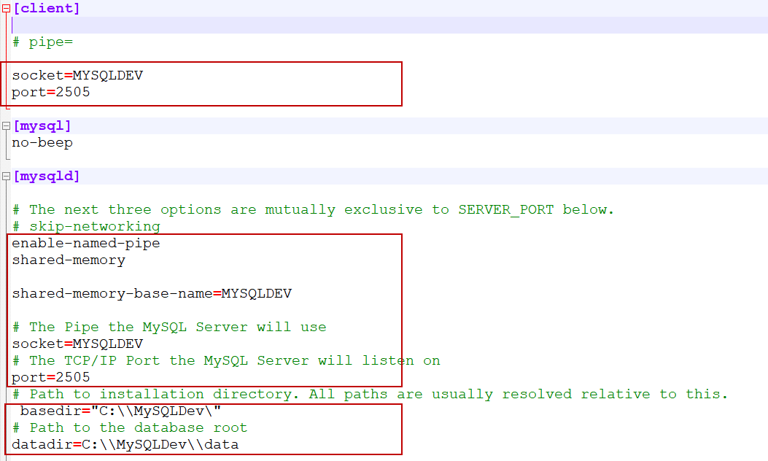

Slide 7
Install MySQL using a new configuration file
To manually install MySQL as a Windows service, use mysqld command line utility. The command is the following:
C:\> mysqld --install MySQLDEV –-defaults-file=”C:\MySQLDev\MyDEV.ini”
The service is installed successfully.

Slide 8
Start MySQL instance
Once MySQL is installed as a windows service, let us start it.
To start the service, open the control panel open Administrative Tools Open Services. In the Services console, you can see the MySQLDEV service is installed. Right-click on it and click on Start.

Slide 9
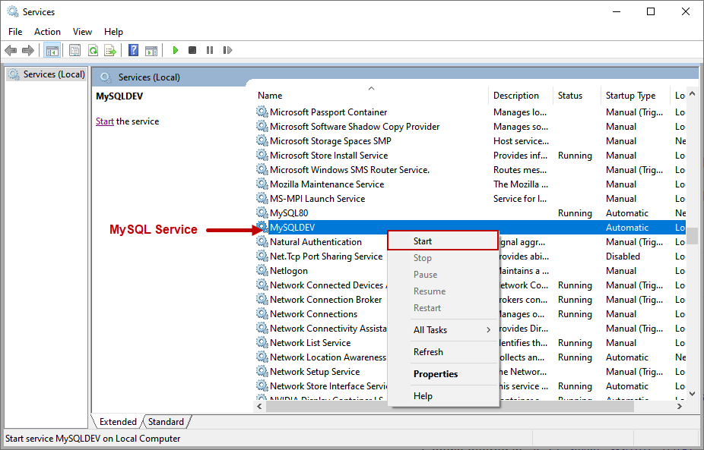

Slide 10
Connect to the new instance
We are using MySQL workbench to check the configurations of the MySQLDev instance.
We are connecting to the MySQLDEV instance, so we must set up a connection in MySQL Workbench. Open MySQL Workbench and click on the (+) icon.

Slide 11
Connect to the new instance
In Setup New Connection dialog box, specify the connection name. We are connecting to MySQL using TCP/IP, so choose Standard (TCP/IP) from the connection method drop-down box.
In the Hostname dialog box, specify the 127.0.0.1 or Localhost.
The new MySQLDEV instance is listening on port number 2505; therefore, in the port number text box, specify 2505.
We are using the root user to connect to the MySQL instance. Click on Test Connection.
MySQL workbench prompts for the password of the root user. Specify the appropriate password and click OK.

Slide 12
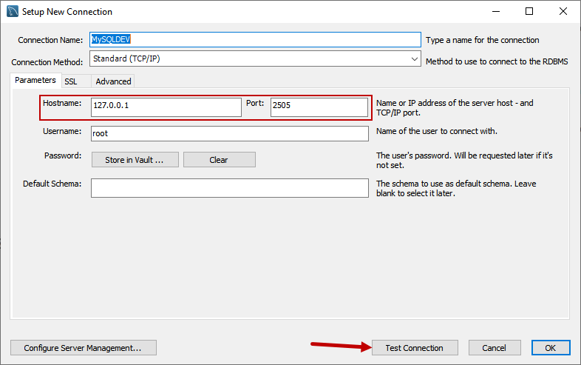

Slide 13
Connecting to the newly created server
Back to the Welcome screen, you can see the connection named MySQLDEV has been added.
Click on it to open the query window.

Slide 14
Check the configuration details
Let us check the configuration of the MySQLDEV instance.
The details can be viewed from the Server Status.
Click on Servers and select Server Status.
Can see the Hostname, socket name, and port number used by the MySQLDEV instance on the Server Status screen.
Can also see the path of the base directory and the data directory of the MySQLDEV instance.
Have copied the entire data directory of the default instance (MySQL80) of MySQL; therefore, the databases created on the MySQL default instance are copied to the MySQLDEV instance.
You can view the list of databases in Schemas pan of Navigator.

Slide 15
Binary Log File Position Based Replication Configuration

Slide 16
Replication between MySQL servers based on the binary log file position
Require MySQL instance operating as the source (where the database changes take place) writes updates and changes as “events” to the binary log.
Information in the binary log is stored in different logging formats according to the database changes being recorded.
Replicas are configured to read the binary log from the source and to execute the events in the binary log on the replica's local database.
Each replica receives a copy of the entire contents of the binary log.
Responsibility of the replica to decide which statements in the binary log should be executed.
Unless you specify otherwise, all events in the source's binary log are executed on the replica.
If required, you can configure the replica to process only events that apply to particular databases or tables.

Slide 17
Replication between MySQL servers based on the binary log file position
Each replica keeps a record of the binary log coordinates: the file name and position within the file that it has read and processed from the source.
This means that multiple replicas can be connected to the source and executing different parts of the same binary log.
Because the replicas control this process, individual replicas can be connected and disconnected from the server without affecting the source's operation.
Also, because each replica records the current position within the binary log, it is possible for replicas to be disconnected, reconnect and then resume processing.

Slide 18
Replication between MySQL servers based on the binary log file position
The source and each replica must be configured with a unique ID (using the server_id system variable).
In addition, each replica must be configured with information about the source's host name, log file name, and position within that file.
These details can be controlled from within a MySQL session using a CHANGE REPLICATION SOURCE TO statement (from MySQL 8.0.23) or CHANGE MASTER TO statement (before MySQL 8.0.23) on the replica.

Slide 19
generic tasks to be performed
On the source, you must ensure that binary logging is enabled, and configure a unique server ID. This might require a server restart.
On each replica that you want to connect to the source, you must configure a unique server ID. This might require a server restart.
Optionally, create a separate user for your replicas to use during authentication with the source when reading the binary log for replication.
Before creating a data snapshot or starting the replication process, on the source you should record the current position in the binary log.
You need this information when configuring the replica so that the replica knows where within the binary log to start executing events

Slide 20
Generic tasks to be performed
If you already have data on the source and want to use it to synchronize the replica, you need to create a data snapshot to copy the data to the replica.
The storage engine you are using has an impact on how you create the snapshot.
When you are using MyISAM, you must stop processing statements on the source to obtain a read-lock, then obtain its current binary log coordinates and dump its data, before permitting the source to continue executing statements.
If you do not stop the execution of statements, the data dump and the source status information become mismatched, resulting in inconsistent or corrupted databases on the replicas.
If you are using InnoDB, you do not need a read-lock and a transaction that is long enough to transfer the data snapshot is sufficient.
Configure the replica with settings for connecting to the source, such as the host name, login credentials, and binary log file name and position

Slide 21
Setting the Replication Source Configuration
To configure a source to use binary log file position based replication, you must ensure that binary logging is enabled, and establish a unique server ID.
Each server within a replication topology must be configured with a unique server ID, which you can specify using the server_id system variable.
This server ID is used to identify individual servers within the replication topology, and must be a positive integer between 1 and (232)−1.
The default server_id value from MySQL 8.0 is 1. You can change the server_id value dynamically by issuing a statement like this:
SET GLOBAL server_id = 2;
or
In MyDev.ini
[mysqld]
server-id=2

Slide 22
Enable binary logging
Binary logging is required on the source because the binary log is the basis for replicating changes from the source to its replicas.
Binary logging is enabled by default (the log_bin system variable is set to ON).
--log-bin option tells the server what base name to use for binary log files.
It is recommended that you specify this option to give the binary log files a non-default base name, so that if the host name changes, you can easily continue to use the same binary log file names
If binary logging was previously disabled on the source using the --skip-log-bin option, you must restart the server without this option to enable it.

Slide 23
Creating a User for Replication
Each replica connects to the source using a MySQL user name and password, so there must be a user account on the source that the replica can use to connect.
The user name is specified by the SOURCE_USER | MASTER_USER option of the CHANGE REPLICATION SOURCE TO statement (from MySQL 8.0.23) or CHANGE MASTER TO statement (before MySQL 8.0.23) when you set up a replica.
Any account can be used for this operation, providing it has been granted the REPLICATION SLAVE privilege.
Can choose to create a different account for each replica, or connect to the source using the same account for each replica.
Although you do not have to create an account specifically for replication, you should be aware that the replication user name and password are stored in plain text in the replica's connection metadata repository mysql.slave_master_info.
Therefore, you may want to create a separate account that has privileges only for the replication process, to minimize the possibility of compromise to other accounts.

Slide 24
Creating a User for Replication
To create a new account, use CREATE USER.
To grant this account the privileges required for replication, use the GRANT statement.
If you create an account solely for the purposes of replication, that account needs only the REPLICATION SLAVE privilege.
For example, to set up a new user, repl, that can connect for replication issue these statements on the source:
mysql> CREATE USER 'repl’@localhost IDENTIFIED BY 'password’;
mysql> GRANT REPLICATION SLAVE ON *.* TO 'repl'@localhost;
Also do the following grant
GRANT REPLICATION_SLAVE_ADMIN ON *.* TO 'repl'@localhost;

Slide 25
Obtaining the Replication Source Binary Log Coordinates
To configure the replica to start the replication process at the correct point, you need to note the source's current coordinates within its binary log.
To obtain the source binary log coordinates, follow these steps:
Start a session on the source by connecting to it with the command-line client, and flush all tables and block write statements by executing the FLUSH TABLES WITH READ LOCK statement:
mysql> FLUSH TABLES WITH READ LOCK;

Slide 26
Obtaining the Replication Source Binary Log Coordinates
In a different session on the source, use the SHOW MASTER STATUS statement to determine the current binary log file name and position:
mysql> SHOW MASTER STATUS\G
*************************** 1. row ***************************
File: mysql-bin.000003
Position: 73
Binlog_Do_DB: test
Binlog_Ignore_DB: manual, mysql
Executed_Gtid_Set: 3E11FA47-71CA-11E1-9E33-C80AA9429562:1-5
1 row in set (0.00 sec)

Slide 27
Obtaining the Replication Source Binary Log Coordinates
File column shows the name of the log file and the Position column shows the position within the file.
In this example, the binary log file is mysql-bin.000003 and the position is 73.
Record these values.
Need them later when you are setting up the replica.
They represent the replication coordinates at which the replica should begin processing new updates from the source.
If the source has been running previously with binary logging disabled, the log file name and position values displayed by SHOW MASTER STATUS or mysqldump --master-data are empty.
In that case, the values that you need to use later when specifying the source's binary log file and position are the empty string ('') and 4.

Slide 28
Obtaining the Replication Source Binary Log Coordinates
If you have existing data that needs be to synchronized with the replica before you start replication, leave the client running so that the lock remains in place.
This prevents any further changes being made, so that the data copied to the replica is in synchrony with the source.
If you are setting up a new source and replica combination, you can exit the first session to release the read lock.

Slide 29
Choosing a Method for Data Snapshots
If the source database contains existing data it is necessary to copy this data to each replica.
There are different ways to dump the data from the source database.
Use the mysqldump tool to create a dump of all the databases you want to replicate. This is the recommended method, especially when using InnoDB.

Slide 30
Creating a snapshot
To create a snapshot of the data in an existing source database, use the mysqldump tool.
Once the data dump has been completed, import this data into the replica before starting the replication process.
The following example dumps all databases to a file named dbdump.db, and includes the --master-data option which automatically appends the CHANGE REPLICATION SOURCE TO | CHANGE MASTER TO statement required on the replica to start the replication process:
$> mysqldump --all-databases --master-data > dbdump.db

Slide 31
Setting Up Replicas - Prerequisites
Configured the source with the necessary configuration properties
Obtained the source status information, or a copy of the source's binary log index file made during a shutdown for the data snapshot.
On the source, released the read lock:
mysql> UNLOCK TABLES;
On the replica, edited the MySQL configuration.

Slide 32
Setting Up Replication with New Source and Replicas
When there is no snapshot of a previous database to import, configure the replica to start replication from the new source.
To set up replication between a source and a new replica:
Start up the replica.
Execute a CHANGE REPLICATION SOURCE TO | CHANGE MASTER TO statement on the replica to set the source configuration.
Perform these replica setup steps on each replica.

Slide 33
Setting the Source Configuration on the Replica
To set up the replica to communicate with the source for replication, configure the replica with the necessary connection information.
To do this, on the replica, execute the CHANGE REPLICATION SOURCE TO statement (from MySQL 8.0.23) or CHANGE MASTER TO statement (before MySQL 8.0.23), replacing the option values with the actual values relevant to your system:

Slide 34
Setting the Source Configuration on the Replica
mysql> CHANGE MASTER TO
-> MASTER_HOST='source_host_name',
-> MASTER_USER='replication_user_name',
-> MASTER_PASSWORD='replication_password',
-> MASTER_LOG_FILE='recorded_log_file_name',
-> MASTER_LOG_POS=recorded_log_position;
Or from MySQL 8.0.23:
mysql> CHANGE REPLICATION SOURCE TO
SOURCE_HOST='source_host_name',
SOURCE_USER='replication_user_name',
SOURCE_PASSWORD='replication_password',
SOURCE_LOG_FILE='recorded_log_file_name',
SOURCE_LOG_POS=recorded_log_position;

